Slide 1

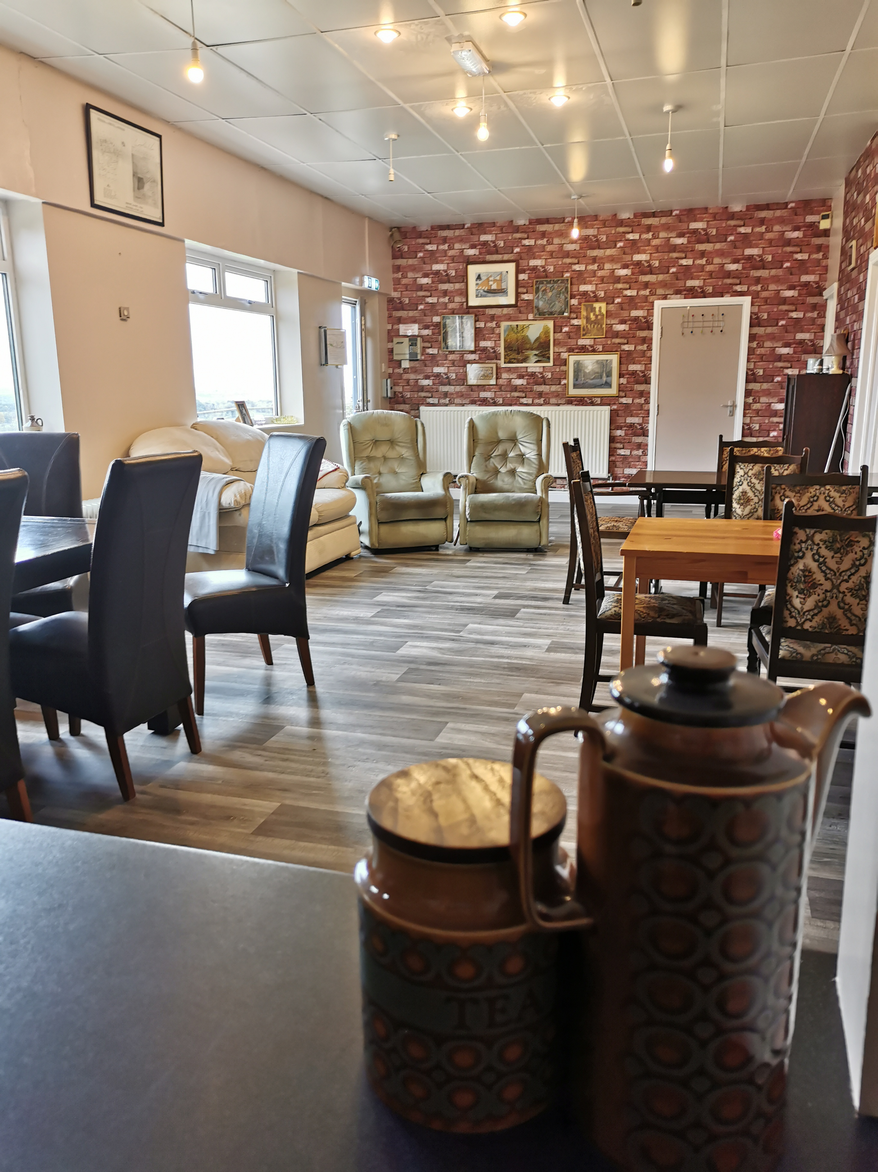
We are a Day Centre for People with Long Term Health Conditions such as Dementia, Parkinson's etc as well as for preventing Social Isolation. We offer Carers the opportunity to leave their loved ones with us for in a safe and relaxing non clinical environment . We spend our time on activities such as baking, reminiscence therapy, mindfulness, music and games with no pressure to join in. We also offer emotional and advice support to carers to enable them to focus on their life's.
Holmes ADULT CARER SERVICE.
Day Centre At Frechville
Monday, to Friday10am to 3.15PM Frecheville Sports Club, Silkstone Rd, S12 4RH Cost £40 to include 2 course meal or £35 without
ETHOS: Support the Carer and their loved one together to achieve what is best for them both. The venue has disabled access and plentiful parking. To book a £5 taster day or for more information contact
Mark Holmes on: 07715253131
email mark.holmes@holmesadultcarerservice.co.uk

